Slide 1



VEEMbot
Raphaël COUTURIER
Enguerrand BOITEL - Elio ELHOYECK - Mohamad Karim MAKHLOUF - Vincent RAMOUSSET
Notes:
Enguerrand
Good afternoon Mr COUTURIER, Mr MAKHOUL
Elio, Mohamad, Vincent and I will present to you VEEMbot, our virtual assistant.
This project has been tutored by you, Mr. Couturier

Slide 2

01
Introduction
02
Organization
03
Detailed presentation
04
Conclusion
SUMMARY
Enguerrand BOITEL - Elio ELHOYECK - Mohamad Karim MAKHLOUF - Vincent RAMOUSSET
Notes:
Enguerrand
Let’s first present the summary :
We’ll start with an introduction and a small video of demonstration, then we’ll present our organization.
After, we will try to detail how VEEMbot works.
We’’ll finish with a conclusion and our personnal opinions

Slide 3
I. Introduction
A. Presentation
Enguerrand BOITEL - Elio ELHOYECK - Mohamad Karim MAKHLOUF - Vincent RAMOUSSET
Notes:
Enguerrand

Slide 4

A. Presentation
What is VEEMbot ?
Enguerrand BOITEL - Elio ELHOYECK - Mohamad Karim MAKHLOUF - Vincent RAMOUSSET
Notes:
Enguerrand
A virtual and vocal assistant that answers questions.

Slide 5

incent
nguerrrand
E
E
M
bot
V
chat
lio
ohamad
Notes:
Enguerrand
VEEMbot is not a simple chatbot, it is OUR chatbot. We spent hours and hours to create it, we tried, we improved, we removed, and we failed, but we never gave up !
We were a small company : each of us had tasks to do, functions to improve, and here is our logo
A,nd his name : VEEMbot ! Why VEEMbot ? Because this algorithm is a personnal investment, in term of time and energy.
We tried thus to give to our assistant a small part of ourselves : the first letter of our first name.
and you understood : bot for chatbot

Slide 6
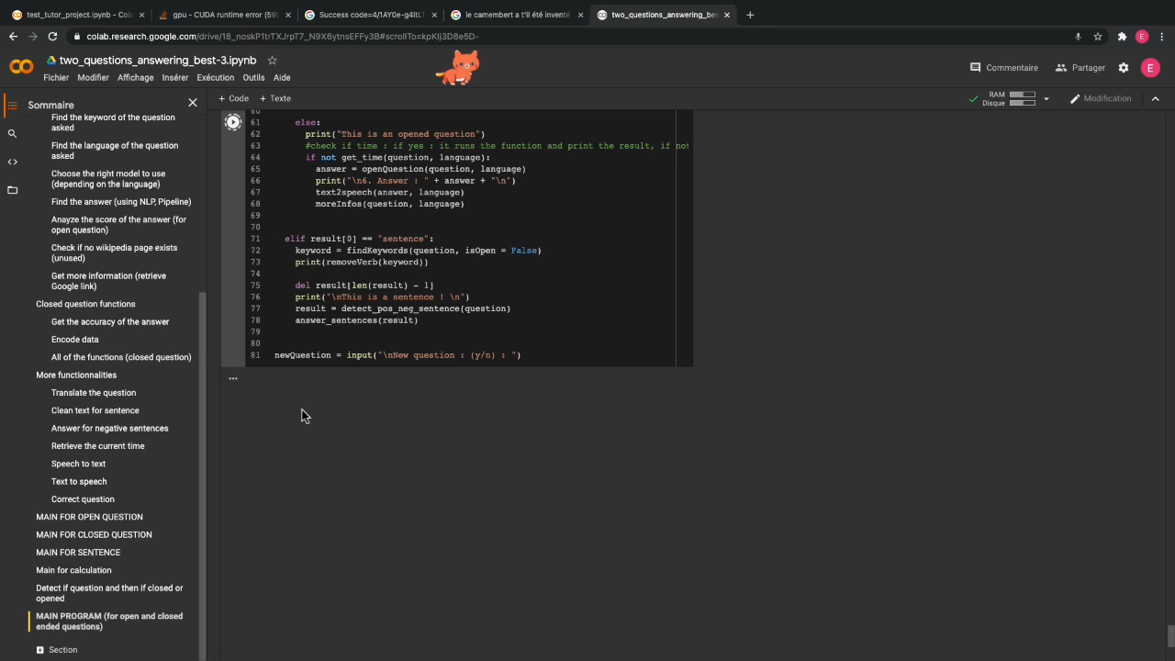
Enguerrand BOITEL - Elio ELHOYECK - Mohamad Karim MAKHLOUF - Vincent RAMOUSSET
Notes:
Enguerrand
Let’s now demonstrate what VEEMbot can do !
Here is a simple question : Where is Montbéliard ?. This question is open which means that there are many different answers possible.
And the answer is « In the doubs department » !
Ok, that’s fine, but this kind of assistant already exist, in many different ways.
Our goal, on the opposite, was to create a complete and easy to use assistant that will answer orally every type of question.

Slide 7
A. Presentation
What is VEEMbot ?
Problematic
Enguerrand BOITEL - Elio ELHOYECK - Mohamad Karim MAKHLOUF - Vincent RAMOUSSET
Notes:
Enguerrand
As we tried to create the most unique and complete assistant, we were thinking about a new way to improve our customer experience using VEEMbot, of course!
Thus, our problematic is the following :

Slide 8
How could VEEMbot be an improvement for our future customers ?
Enguerrand BOITEL - Elio ELHOYECK - Mohamad Karim MAKHLOUF - Vincent RAMOUSSET
Notes:
Enguerrand

Slide 9
I. Introduction
B. Objectives
Enguerrand BOITEL - Elio ELHOYECK - Mohamad Karim MAKHLOUF - Vincent RAMOUSSET
Notes:
Mohamad

Slide 10
B. Objectives
Answer a question
Propose several functionalities
Answer in multiple languages
Enguerrand BOITEL - Elio ELHOYECK - Mohamad Karim MAKHLOUF - Vincent RAMOUSSET
Notes:
Mohamad

Slide 11
I. Introduction
C. Project Target
Enguerrand BOITEL - Elio ELHOYECK - Mohamad Karim MAKHLOUF - Vincent RAMOUSSET
Notes:
Elio

Slide 12
Target
Huge companies : supermarkets
Small companies
Enguerrand BOITEL - Elio ELHOYECK - Mohamad Karim MAKHLOUF - Vincent RAMOUSSET
Notes:
Elio

Slide 13
I. Introduction
D. State Of The Art
Enguerrand BOITEL - Elio ELHOYECK - Mohamad Karim MAKHLOUF - Vincent RAMOUSSET
Notes:
Elio

Slide 14
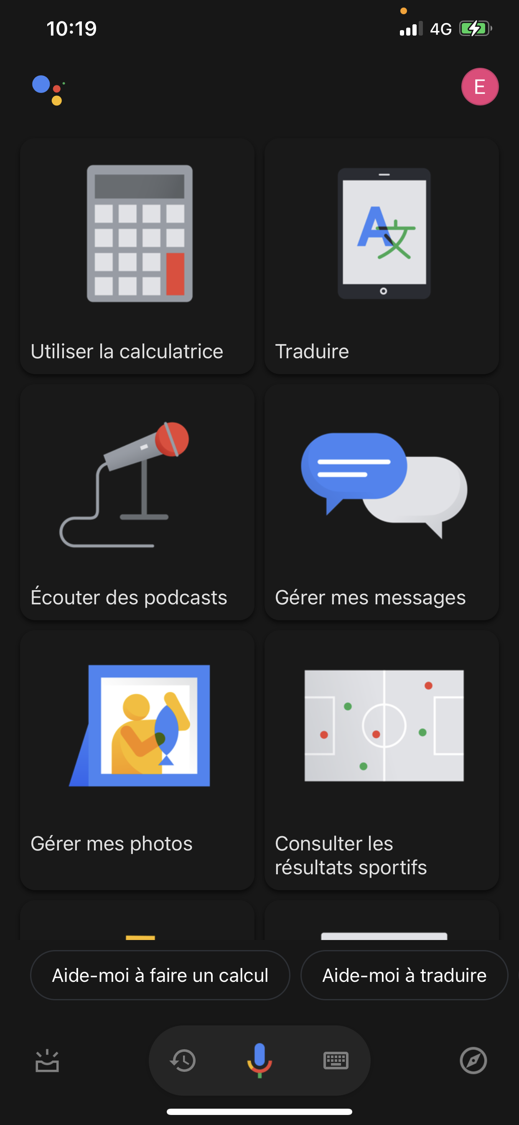
VEEMbot
Top known assistants
Pros and cons
« What can you do ? »
Enguerrand BOITEL - Elio ELHOYECK - Mohamad Karim MAKHLOUF - Vincent RAMOUSSET
Notes:
Elio

Slide 15
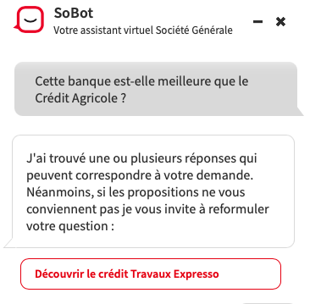
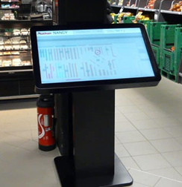
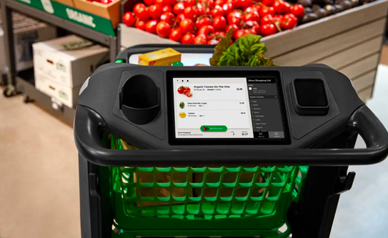
VEEMbot
Boursorama Smart Assistant, Societe Genrale’s SoBot
Supermaket virtual assistants
Additional findings
Common problems
Enguerrand BOITEL - Elio ELHOYECK - Mohamad Karim MAKHLOUF - Vincent RAMOUSSET
Notes:
Elio

Slide 16
II. Organization
A. Global Organization
Enguerrand BOITEL - Elio ELHOYECK - Mohamad Karim MAKHLOUF - Vincent RAMOUSSET
Notes:
Vincent

Slide 17
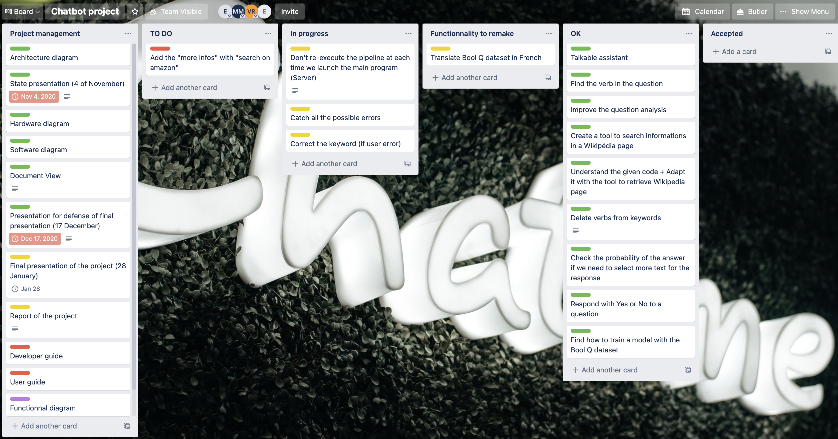
ORGANIZATION
Creation of documents for the project management
Use of communication and project management tools
Enguerrand BOITEL - Elio ELHOYECK - Mohamad Karim MAKHLOUF - Vincent RAMOUSSET
Notes:
Vincent
Creation of documents for the project management → Objectives we want to achieve, the diagrams to have a better view of what we need to do
Use of communication tools → Whatsapp (to discuss between us), Discord (for the online work between us), Google Meet (for the meeting with Mr. Couturier), Mail (to fix a meeting with Mr. Couturier) and oral voice to discuss between us or with Mr. Couturier to do meetings when we have courses
Use of project management tools → Trello (to know what it’s done and what we need to do, planify some tasks to do before one day of a month), Google Drive (to share the different documents about the project -- it can be presentation, report, diagrams, ...)
AGILE method → Beginning of each meeting : we make a balance sheets of what we have done ; During each meeting : define a time slot to work on the problems ; End of a meeting : we discuss to know what we need to do for/during the next meeting and ask questions to our tutor (if necessary) ; We plan a new meeting with Mr. COUTURIER (tomorrow we have a meeting). For the code : we develop the code, we test it and implement it in the main program if it’s good

Slide 18
II. Organization
B. Agile Method
Enguerrand BOITEL - Elio ELHOYECK - Mohamad Karim MAKHLOUF - Vincent RAMOUSSET
Notes:
Enguerrand

Slide 19
B. Agile Method
Time slots defined
to solve problems
Balance sheets
Plan the next tasks for everyone
During
Before
After
Meeting
Notes:
Enguerrand

Slide 20
II. Organization
C. Architecture
Enguerrand BOITEL - Elio ELHOYECK - Mohamad Karim MAKHLOUF - Vincent RAMOUSSET
Notes:
Vincent

Slide 21
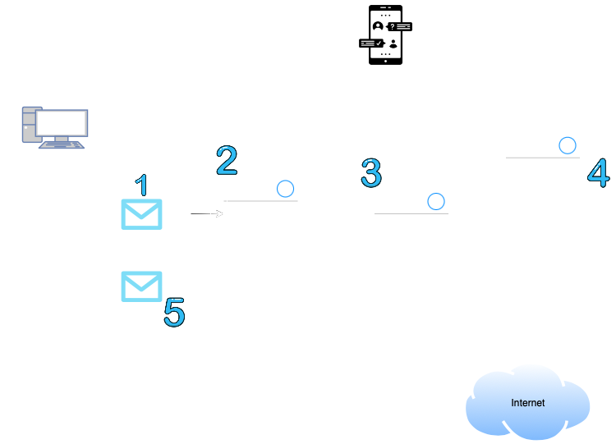
Architecture diagram
Notes:
Vincent

Slide 22
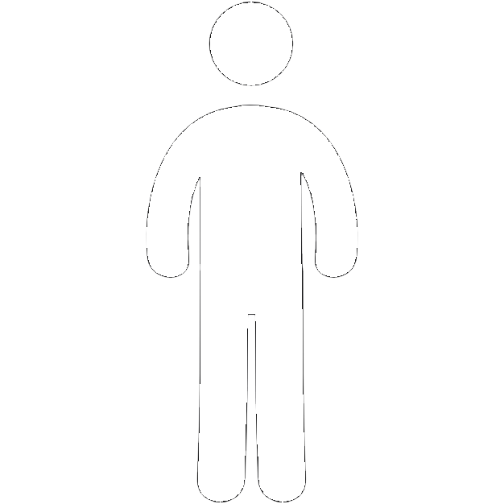
Actors
Administration
Communication
Creators
Enguerrand BOITEL - Elio ELHOYECK - Mohamad Karim MAKHLOUF - Vincent RAMOUSSET
Notes:
Vincent

Slide 23
II. Organization
D. Hardware configuration
Enguerrand BOITEL - Elio ELHOYECK - Mohamad Karim MAKHLOUF - Vincent RAMOUSSET
Notes:
Mohamad

Slide 24
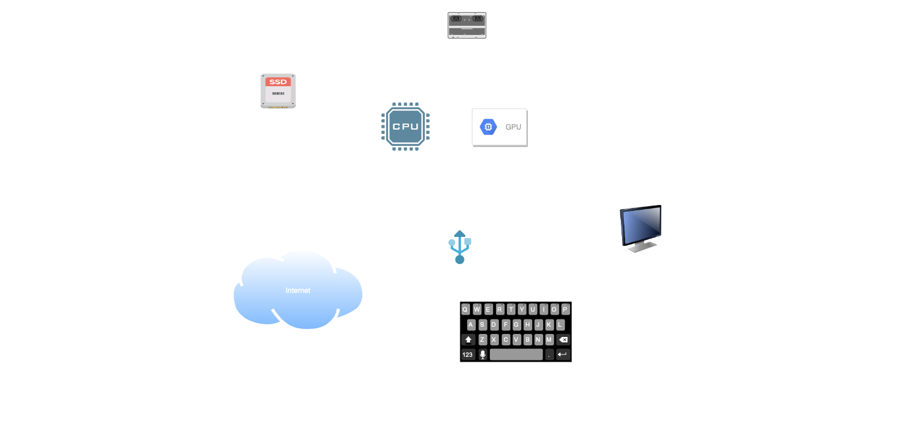
Hardware diagram
Notes:
Mohamad

Slide 25
III. Detailed presentation
A. Algorithm Organization
Enguerrand BOITEL - Elio ELHOYECK - Mohamad Karim MAKHLOUF - Vincent RAMOUSSET
Notes:
Enguerrand

Slide 26

Algorithm diagram
Enguerrand BOITEL - Elio ELHOYECK - Mohamad Karim MAKHLOUF - Vincent RAMOUSSET
Notes:
Enguerrand

Slide 27
Step 1 : Analyze the sentence
Get language
Get keyword
Remove verb in keyword
Step 1
Enguerrand BOITEL - Elio ELHOYECK - Mohamad Karim MAKHLOUF - Vincent RAMOUSSET
Notes:
Enguerrand

Slide 28

Step 1 : Analyze the sentence
Enguerrand BOITEL - Elio ELHOYECK - Mohamad Karim MAKHLOUF - Vincent RAMOUSSET
Notes:
Enguerrand

Slide 29
Step 2 : Get data
Get summary
Select topic
Get more information
Step 2
Enguerrand BOITEL - Elio ELHOYECK - Mohamad Karim MAKHLOUF - Vincent RAMOUSSET
Notes:
Mohamad

Slide 30

Step 2 : Get data
Enguerrand BOITEL - Elio ELHOYECK - Mohamad Karim MAKHLOUF - Vincent RAMOUSSET
Notes:
Mohamad

Slide 31
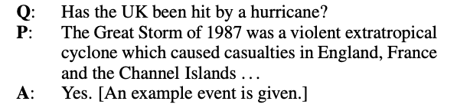
Step 3 : Find answer
Step 3
Closed-ended question
Enguerrand BOITEL - Elio ELHOYECK - Mohamad Karim MAKHLOUF - Vincent RAMOUSSET
Notes:
Elio

Slide 32
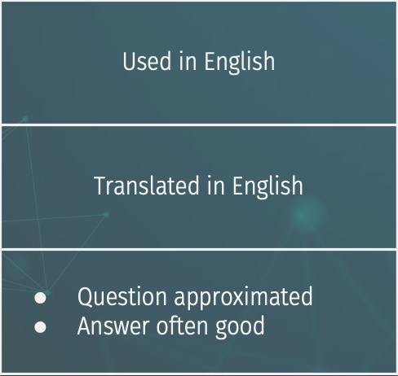
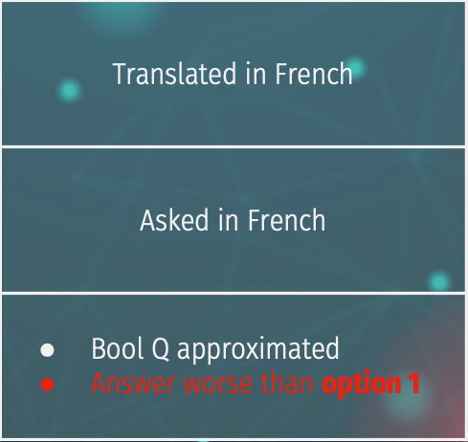
Closed questions
Choice | 1 | 2
Bool-Q dataset
Question
Results
Enguerrand BOITEL - Elio ELHOYECK - Mohamad Karim MAKHLOUF - Vincent RAMOUSSET
Notes:
Elio
See the Results part in the table → With the real results

Slide 33
Step 3 : Find answer
Step 3
Closed-ended question
Open-ended question
Time-depending question
Calculation
Sentence
Enguerrand BOITEL - Elio ELHOYECK - Mohamad Karim MAKHLOUF - Vincent RAMOUSSET
Notes:
Vincent

Slide 34

Step 3 : Find answer
Enguerrand BOITEL - Elio ELHOYECK - Mohamad Karim MAKHLOUF - Vincent RAMOUSSET
Notes:
Vincent

Slide 35
Step 4 : Analyze the score
Step 4
Questions
Sentence
Enguerrand BOITEL - Elio ELHOYECK - Mohamad Karim MAKHLOUF - Vincent RAMOUSSET
Notes:
Enguerrand

Slide 36
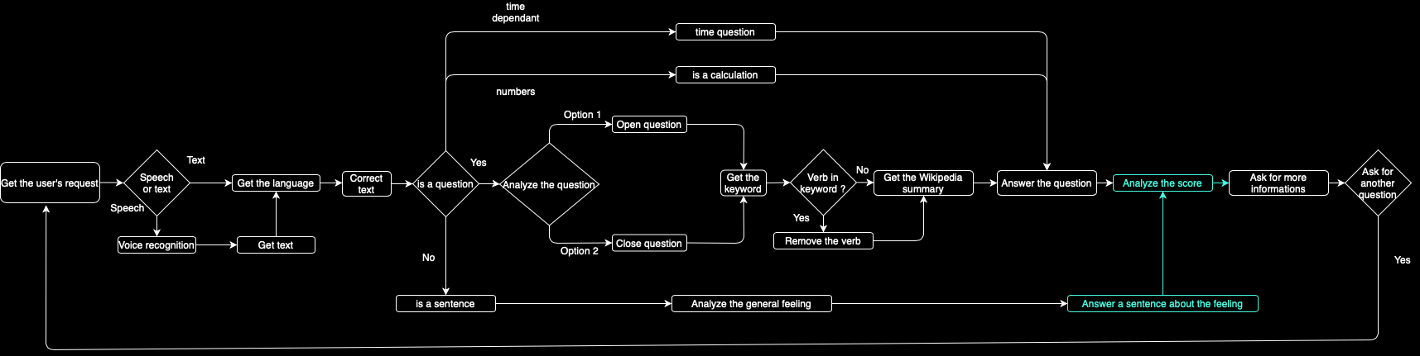
Step 4 : Analyze the score
Enguerrand BOITEL - Elio ELHOYECK - Mohamad Karim MAKHLOUF - Vincent RAMOUSSET
Notes:
Enguerrand

Slide 37
Step 5 : Communicate orally
Step 5
Speech to text
Text to speech
Enguerrand BOITEL - Elio ELHOYECK - Mohamad Karim MAKHLOUF - Vincent RAMOUSSET
Notes:
Mohamad

Slide 38
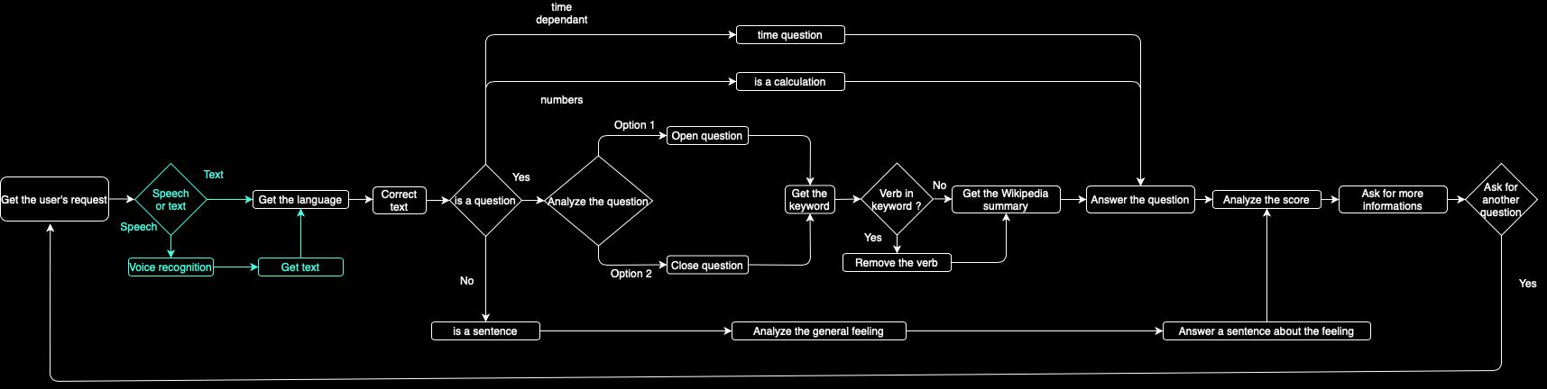
Step 5 : Communicate orally
Enguerrand BOITEL - Elio ELHOYECK - Mohamad Karim MAKHLOUF - Vincent RAMOUSSET
Notes:
Mohamad

Slide 39
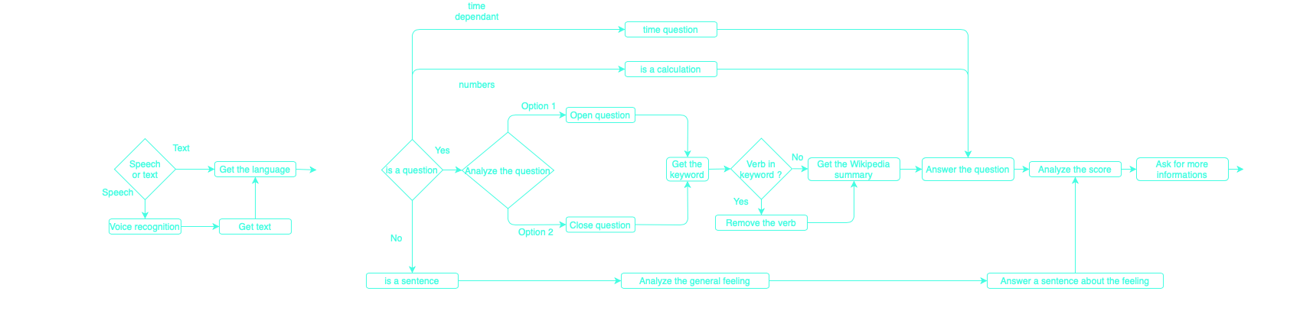
Algorithm diagram
Enguerrand BOITEL - Elio ELHOYECK - Mohamad Karim MAKHLOUF - Vincent RAMOUSSET
Notes:
Mohamad

Slide 40
III. Detailed presentation
B. Balance sheets
Enguerrand BOITEL - Elio ELHOYECK - Mohamad Karim MAKHLOUF - Vincent RAMOUSSET
Notes:
Enguerrand / Vincent

Slide 41
B. Balance sheets
Technical skills
Python skills (on Colab)
AI skills (NLP, NLTK, Transformers)
Data analysis and improvement
Enguerrand BOITEL - Elio ELHOYECK - Mohamad Karim MAKHLOUF - Vincent RAMOUSSET
Notes:
Enguerrand / Vincent

Slide 42
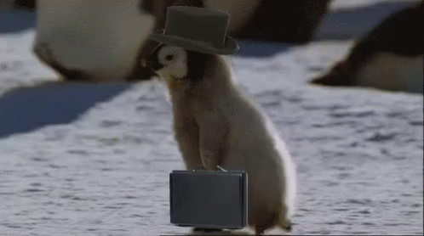
B. Balance sheets
Soft skills
Team work
New way to work : remotely
Crucial organization
Enguerrand BOITEL - Elio ELHOYECK - Mohamad Karim MAKHLOUF - Vincent RAMOUSSET
Notes:
Elio

Slide 43
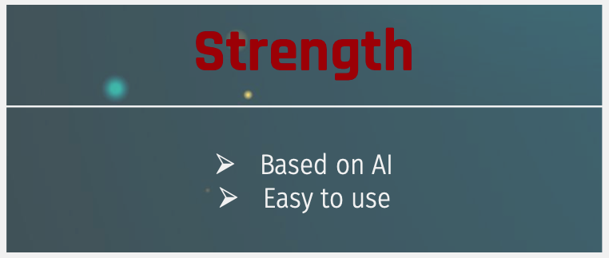

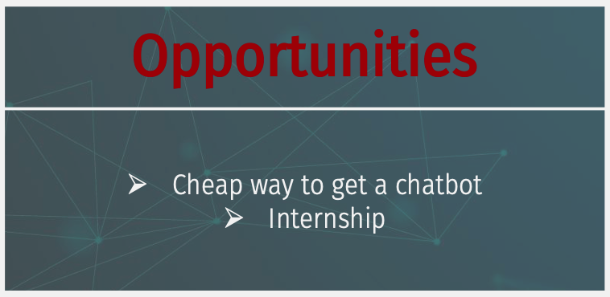
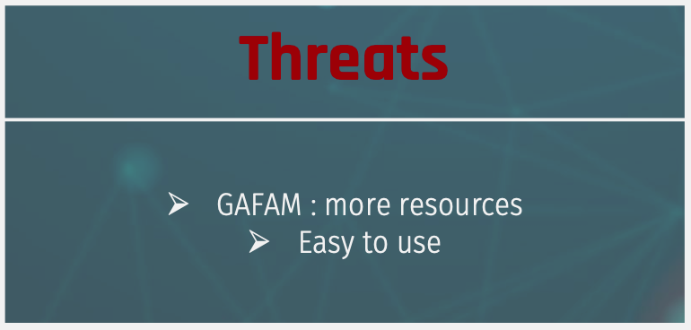
SWOT
Enguerrand BOITEL - Elio ELHOYECK - Mohamad Karim MAKHLOUF - Vincent RAMOUSSET
Enguerrand BOITEL - Elio ELHOYECK - Mohamad Karim MAKHLOUF - Vincent RAMOUSSET
Enguerrand BOITEL - Elio ELHOYECK - Mohamad Karim MAKHLOUF - Vincent RAMOUSSET
Enguerrand BOITEL - Elio ELHOYECK - Mohamad Karim MAKHLOUF - Vincent RAMOUSSET
Notes:
Strength : Enguerrand
Weakness : Mohamad
Opportunities : Elio
Threat : Vincent

Slide 44
DEMONSTRATION
Enguerrand BOITEL - Elio ELHOYECK - Mohamad Karim MAKHLOUF - Vincent RAMOUSSET
Notes:
Enguerrand principalement (tout le monde peut parler)

Slide 45
IV. Conclusion
Enguerrand BOITEL - Elio ELHOYECK - Mohamad Karim MAKHLOUF - Vincent RAMOUSSET
Notes:
Mohamad

Slide 46
CONCLUSION
Contribution statement
Documentations
Remote work
Knowledge shared
Possible improvement
Enguerrand BOITEL - Elio ELHOYECK - Mohamad Karim MAKHLOUF - Vincent RAMOUSSET
Notes:
Mohamad

Slide 47
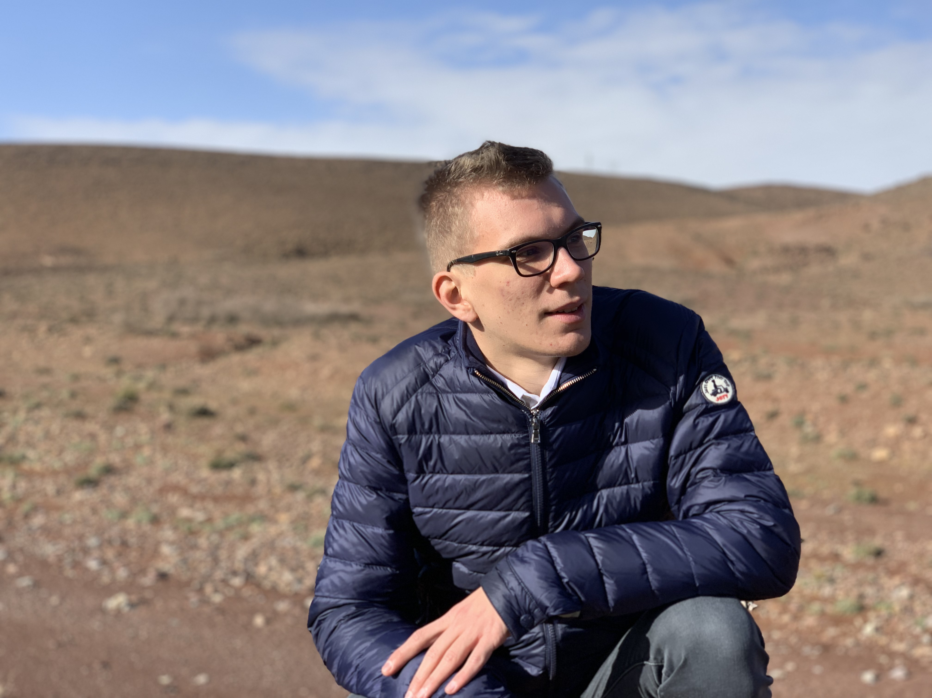
Personal Opinions
ENGUERRAND
Some remaining improvements
Small company
Enguerrand BOITEL - Elio ELHOYECK - Mohamad Karim MAKHLOUF - Vincent RAMOUSSET
Notes:
Enguerrand

Slide 48
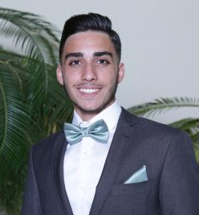
Personal Opinions
ELIO
Lack of French dataset for close-ended questions
Human jobs replacement
Enguerrand BOITEL - Elio ELHOYECK - Mohamad Karim MAKHLOUF - Vincent RAMOUSSET
Notes:
Elio

Slide 49
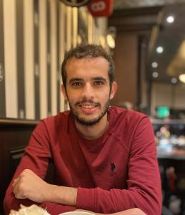
Personal Opinions
MOHAMAD
Adding new features
Resolving translation issues
Enguerrand BOITEL - Elio ELHOYECK - Mohamad Karim MAKHLOUF - Vincent RAMOUSSET
Notes:
Mohamad

Slide 50
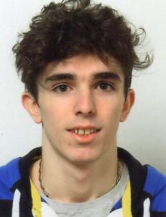
Personal Opinions
VINCENT
Prepare data
Understand advanced assistants
Enguerrand BOITEL - Elio ELHOYECK - Mohamad Karim MAKHLOUF - Vincent RAMOUSSET
Notes:
Vincent

Slide 51
Interested in VEEMbot ? Contact us ! 👺
Enguerrand : enguerrand.boitel@hei.yncrea.fr Elio : eliohoyeck@gmail.com Mohamad : mohamad.makhlouf@utbm.fr Vincent : vincent.ramousset@edu.univ-fcomte.fr
Enguerrand BOITEL - Elio ELHOYECK - Mohamad Karim MAKHLOUF - Vincent RAMOUSSET
Notes:
Vincent

Slide 57
VEEMbot : an interesting project ?
01
02
‘’YES’’ or ‘’No’’ question
Does not exist for supermakets
Usable on multiple supports
State of the art
Demonstration
Enguerrand BOITEL - Elio ELHOYECK - Mohamad Karim MAKHLOUF - Vincent RAMOUSSET
Notes:
Elio

Slide 58
III. Detailed presentation
Demonstration
Problematic
Enguerrand BOITEL - Elio ELHOYECK - Mohamad Karim MAKHLOUF - Vincent RAMOUSSET

Slide 59
01
INTRODUCTION
INTRODUCTION
Easy to process text
Software
Can help or entertain people
Enguerrand BOITEL - Elio ELHOYECK - Mohamad Karim MAKHLOUF - Vincent RAMOUSSET
Notes:
Mohamad
Easy to process text → Nowadays it’s very easy to process text
Software → It is developed to be able to speak with people for some reasons
Can help or entertain people → Help in companies (if there is a problem with a software for example) or entertain people (can talk with a chatbot for fun or to kill time)

Slide 60

Objectives
Answer an open
and a
closed question
Answer in multiple languages
Enguerrand BOITEL - Elio ELHOYECK - Mohamad Karim MAKHLOUF - Vincent RAMOUSSET
Notes:
Elio

Slide 61
01
02
03
ORGANIZATION
PRESENTATION
INTRODUCTION
ORGANIZATION
Creation of documents for the project management
Use of communication and project management tools
AGILE Method
Enguerrand BOITEL - Elio ELHOYECK - Mohamad Karim MAKHLOUF - Vincent RAMOUSSET
Notes:
Vincent
Creation of documents for the project management → Objectives we want to achieve, the diagrams to have a better view of what we need to do
Use of communication tools → Whatsapp (to discuss between us), Discord (for the online work between us), Google Meet (for the meeting with Mr. Couturier), Mail (to fix a meeting with Mr. Couturier) and oral voice to discuss between us or with Mr. Couturier to do meetings when we have courses
Use of project management tools → Trello (to know what it’s done and what we need to do, planify some tasks to do before one day of a month), Google Drive (to share the different documents about the project -- it can be presentation, report, diagrams, ...)
AGILE method → Beginning of each meeting : we make a balance sheets of what we have done ; During each meeting : define a time slot to work on the problems ; End of a meeting : we discuss to know what we need to do for/during the next meeting and ask questions to our tutor (if necessary) ; We plan a new meeting with Mr. COUTURIER (tomorrow we have a meeting). For the code : we develop the code, we test it and implement it in the main program if it’s good

Slide 62
SWOT
Strength | Weakness
Based on AI Easy to use | Score not reliable Long answer
Opportunities | Threats
Cheap way to get a chatbot Internship | GAFAM : more resources Easy to use
Enguerrand BOITEL - Elio ELHOYECK - Mohamad Karim MAKHLOUF - Vincent RAMOUSSET

Slide 63
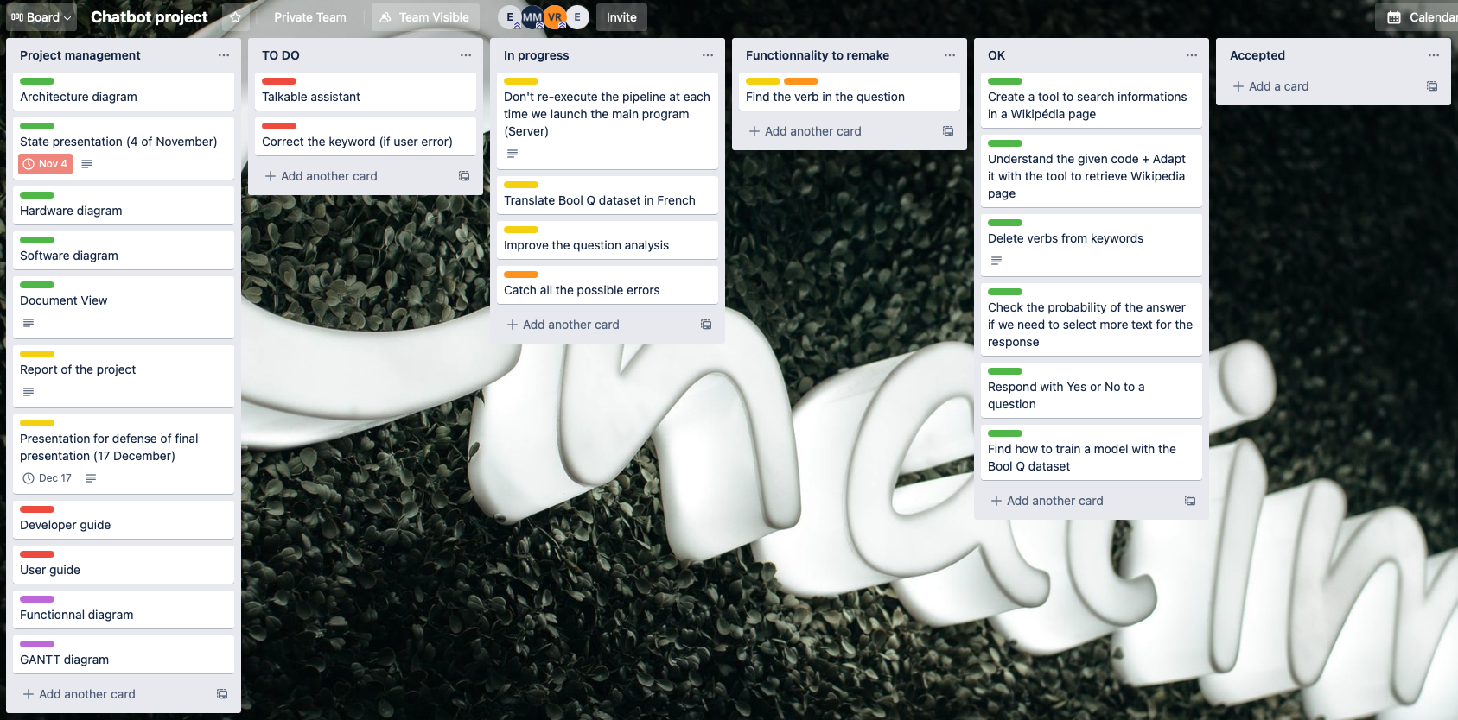
01
02
03
PRESENTATION
INTRODUCTION
ORGANIZATION
Enguerrand BOITEL - Elio ELHOYECK - Mohamad Karim MAKHLOUF - Vincent RAMOUSSET
Notes:
Vincent
Image of Trello
Some parts : project management (documents about the project), parts to do, parts in progress (we have beginned but not finish), functionalities to remake (test are not good enough), ok functionalities (functionalities which have passed the different tests)
Can see that it still two improvements to begin and some to complete

Slide 64
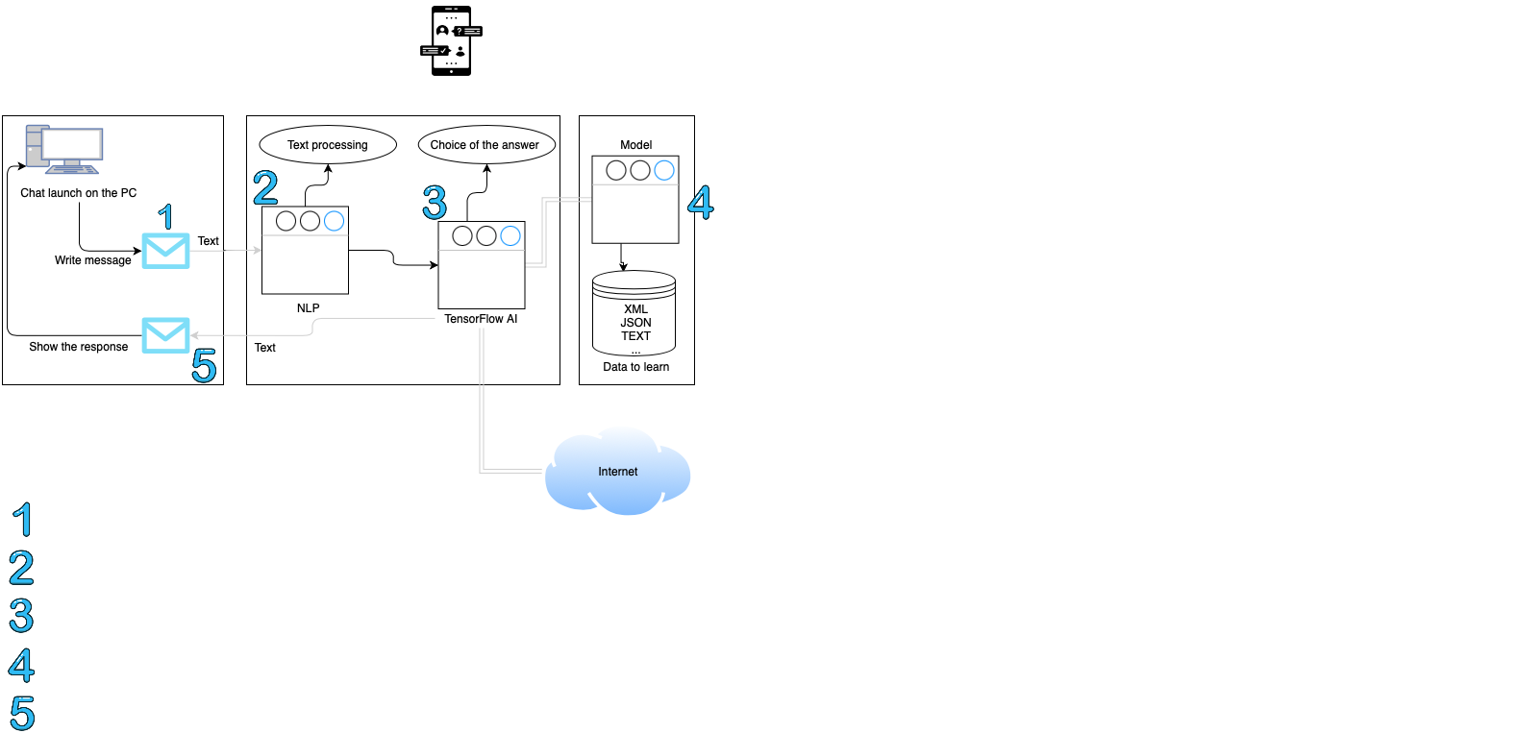
Architecture diagram
Enguerrand BOITEL - Elio ELHOYECK - Mohamad Karim MAKHLOUF - Vincent RAMOUSSET
Notes:
Vincent
Three parts in the diagram : Presentation, application and data
Presentation → To write the question the AI need to respond and to write the response of the AI
Application → Text processing (analyse the question to get the topic and understanding of the question) and choice of the answer (get the text about the topic on the Internet and choose the answer after understand the question via NLP)
Data → The AI is based on a model, this part is to understand how to fit a model (we fit the model on datas which can be images, text, JSON, …)
Administration → Maintain the tool and upgrade it (for example correction of deprecated tool), help the user when he uses the application
Communication → If we have done a good work, we have presented our work to a company via video
Actors → Mr. Couturier (responsible of the project and user of this tool), us who are the developers of this tool

Slide 65
Hardware diagram
Enguerrand BOITEL - Elio ELHOYECK - Mohamad Karim MAKHLOUF - Vincent RAMOUSSET
Notes:
Mohamad

Slide 66
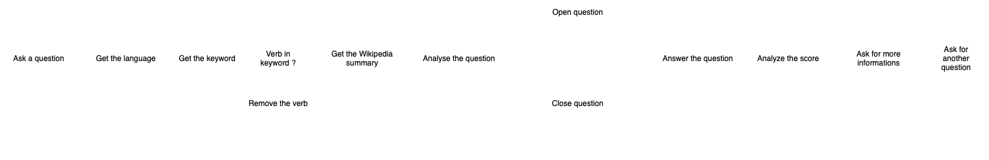
Software diagram
Enguerrand BOITEL - Elio ELHOYECK - Mohamad Karim MAKHLOUF - Vincent RAMOUSSET
Notes:
Vincent
Describe the diagram

Slide 67
01
02
03
04
OUR PROJECT
PRESENTATION
OUR PROJECT
INTRODUCTION
ORGANIZATION
Created an open-question answering
Created a closed-question answering
Gathered them into one single algorithm
Remaining work
Balance sheet
Enguerrand BOITEL - Elio ELHOYECK - Mohamad Karim MAKHLOUF - Vincent RAMOUSSET
Notes:
Mohamad

Slide 68
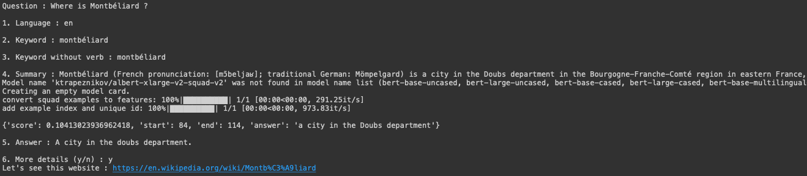
Open questions
Get the language
Get the keyword
Remove the verb
Retrieve a summary using the Wikipedia - API
Answer using NLP
Analyze the score of the answer
Enguerrand BOITEL - Elio ELHOYECK - Mohamad Karim MAKHLOUF - Vincent RAMOUSSET
Notes:
Enguerrand

Slide 69
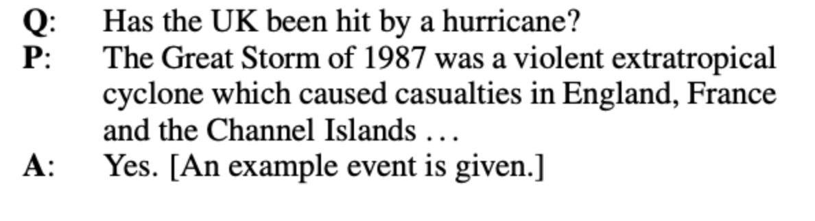
Closed questions
Use of the Bool-Q dataset
Use of functionalities of open questions part
Response by YES or NO
More complicated than Open questions
Two options (french question)
Screenshot of a test of the Bool Q answering
Enguerrand BOITEL - Elio ELHOYECK - Mohamad Karim MAKHLOUF - Vincent RAMOUSSET
Notes:
Elio

Slide 70
Closed questions
Choice | 1 | 2
Bool-Q dataset | Used in English | Translated in French
Question | Translated in English | Asked in French
Results | Question approximated Answer often good | Bool Q approximated Answer worse than option 1
Enguerrand BOITEL - Elio ELHOYECK - Mohamad Karim MAKHLOUF - Vincent RAMOUSSET
Notes:
Elio
See the Results part in the table → With the real results

Slide 71

Solution to implement the two codes
Group the two codes into one
First word is a verb → Closed question
Select the good part to execute
Enguerrand BOITEL - Elio ELHOYECK - Mohamad Karim MAKHLOUF - Vincent RAMOUSSET
Notes:
Elio

Slide 72
Detailed software diagram
Enguerrand BOITEL - Elio ELHOYECK - Mohamad Karim MAKHLOUF - Vincent RAMOUSSET
Notes:
Enguerrand

Slide 73
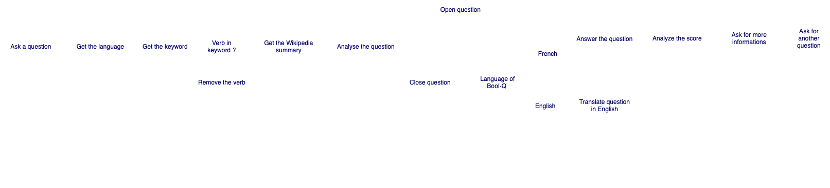
Detailed software diagram
Enguerrand BOITEL - Elio ELHOYECK - Mohamad Karim MAKHLOUF - Vincent RAMOUSSET
Notes:
Enguerrand

Slide 74
Remaining work
Use a server part to accelerate the treatment (open question only)
Implement a talkable assistant
Improve the question analysis
Catch all the remaining code errors
Check and correct the errors in the question
Enguerrand BOITEL - Elio ELHOYECK - Mohamad Karim MAKHLOUF - Vincent RAMOUSSET
Notes:
Vincent
What are the remaining works we need to ?
We can use a server to accelerate the treatment because we reload at each execution the models
Implement a talkable assistant to be more interactive
Improve the question analysis to choose which option we will choose (open question or closed question)
Catch all the remaining code errors to avoid as much as possible the possible crashes and problems generated by the program
Check and correct the errors in the question of the user can make when he tapes on his keyboard

Slide 75

Balance Sheet
Faced some problems
Took decisions
Improved our AI skills
Organized pretty well
Enguerrand BOITEL - Elio ELHOYECK - Mohamad Karim MAKHLOUF - Vincent RAMOUSSET
Notes:
Mohamad
Organization at the beginning was not so good, and improved at the end

Slide 76
01
02
03
04
05
CONCLUSION
PRESENTATION
OUR PROJECT
INTRODUCTION
ORGANIZATION
CONCLUSION
Good progress
New goal : create a talkable assistant
Some little improvements remaining
Enguerrand BOITEL - Elio ELHOYECK - Mohamad Karim MAKHLOUF - Vincent RAMOUSSET
Notes:
Vincent
Project is in good progress than the last presentation of the 4th November → Improvement of some tasks, some solutions to go more quickly are in minds
New goal → Create a talkable assistant which we can talk and it responds at the question we have asked to it
Improvements remaining to have a good assistant (example : the question detection can be an improvement to do)

Slide 77

DEMONSTRATION
Enguerrand BOITEL - Elio ELHOYECK - Mohamad Karim MAKHLOUF - Vincent RAMOUSSET
Notes:
Enguerrand principalement (tout le monde peut parler)

Slide 78
THANKS FOR YOUR ATTENTION
ANY QUESTIONS ?
Enguerrand BOITEL - Elio ELHOYECK - Mohamad Karim MAKHLOUF - Vincent RAMOUSSET
Notes:
Vincent

Slide 80
NAME OF YOUR SECTION
01
You could enter a subtitle here if you need it

Slide 81
WHAT SETS US APART?
MARS
NEPTUNE
VENUS
Despite being red, Mars is actually a cold place. It’s full of iron oxide dust
Neptune is the fourth-largest planet in our Solar System
Venus has a beautiful name and is the second planet from the Sun

Slide 82
HOW DO WE DO IT?
VENUS
Venus has a beautiful name, but it’s terribly hot
MERCURY
Mercury is the smallest planet in our Solar System
SATURN
Saturn is composed of hydrogen and helium

Slide 83
WHAT DO WE OFFER?
01 | 02 | 03 | 04
Mercury is the smallest planet in our Solar System | Jupiter is the biggest planet in our Solar System | Venus has a beautiful name, but it’s terribly hot | Saturn is composed of hydrogen and helium

Slide 84
OUR CLIENTS
Mercury is the smallest planet in our Solar System
Venus has a beautiful name, but it’s terribly hot
MERCURY
VENUS
JUPITER
SATURN
Jupiter is the biggest planet in our Solar System
Saturn is composed of hydrogen and helium

Slide 85
WHAT DO THEY SAY ABOUT US?
MARS
VENUS
MERCURY
NEPTUNE
SATURN
JUPITER
Despite being red, Mars is actually a cold place
Venus has a beautiful name, but it’s terribly hot
Mercury is the closest planet to the Sun
Neptune is the farthest planet from the Sun
Saturn is composed of hydrogen and helium
Jupiter is the biggest planet in our Solar System

Slide 86
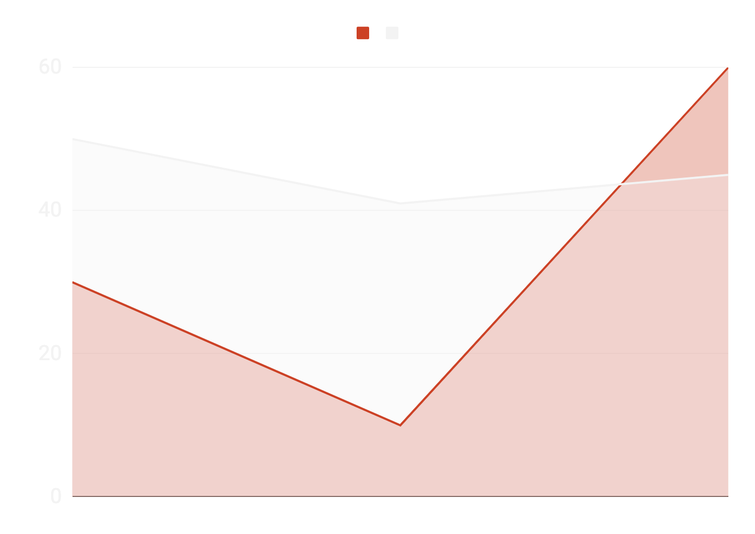
OUR GROWTH
Jupiter is a gas giant and the biggest planet
Mercury is the closest planet to the Sun
If you want to modify this graph, click on it, follow the link, change the data and replace it here

Slide 87
MEET THE TEAM
JENNA DOE
JAMES PATTERSON
You can replace the image on the screen with your own
You can replace the image on the screen with your own

Slide 88

SOFTWARE DESKTOP
Mercury is the closest planet to the Sun and the smallest one in the Solar System—it’s only a bit larger than our Moon

Slide 89
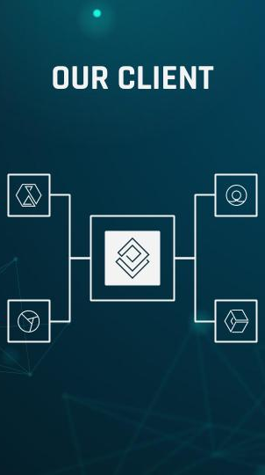
MOBILE APP
Venus has a beautiful name and is the second planet from the Sun. It’s terribly hot and its atmosphere is extremely poisonous

